Slide 1
Lecture 23: The Environment & International Economics
Prof. Theising
Environmental Economics Econ 4075

Slide 2
We have reviewed several national policies – prescriptive, market-based, and more – that support the environment and economic activity.
While you’ve hopefully gotten a rich flavor of American environmental policy, it’s apparent our discussion has been abstracting from something.
National environmental policy decisions trickle through the world economy; thinking through ripple effects is a complex general equilibrium exercise.
Today we’ll consider environmental policy from a more global perspective.

Slide 3
Roadmap
The effect of trade on the environment
The effect of environmental policy on trade (and the environment)
Trade policy as environmental policy?
Leakage and border pollution taxes
International Environmental Agreements

Slide 4
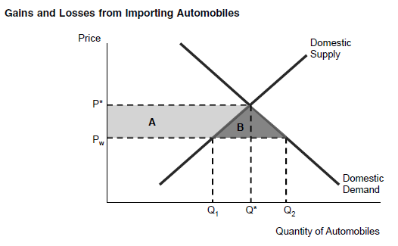
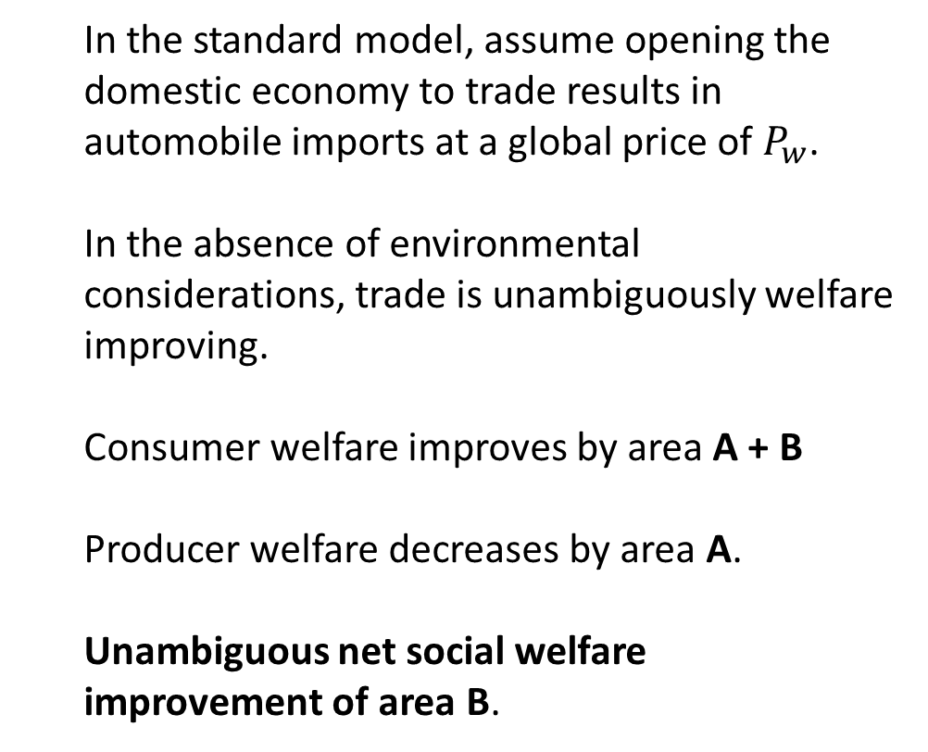
Trade’s impact on domestic environmental quality:
A stylized example
In the standard model, assume opening the domestic economy to trade results in automobile imports at a global price of $P_{w}$.
In the absence of environmental considerations, trade is unambiguously welfare improving.
Consumer welfare improves by area A + B
Producer welfare decreases by area A.
Unambiguous net social welfare improvement of area B.

Slide 5
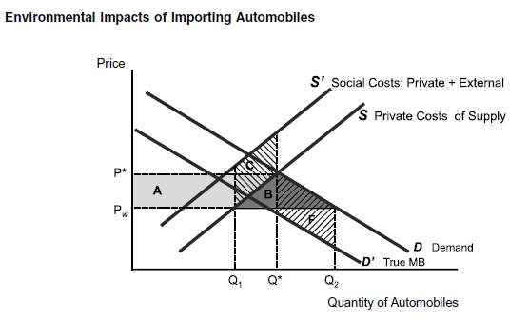
Trade’s impact on domestic environmental quality:
A stylized example
Now let’s include environmental considerations.
Domestic automobile production results in external pollution costs (See curve S’).
The reduction in domestic production from trade means the domestic economy reduces external production costs by area C.
Domestic automobile consumption also results in external pollution costs (See curve D’).
The increase in domestic consumption from trade means the domestic economy increases external consumption costs by area F.
Result: theoretically ambiguous whether automobile trade is welfare-improving (and environment-improving) for importing* economy.
*Converse arguments also result in ambiguous impact for exporting economy.

Slide 6
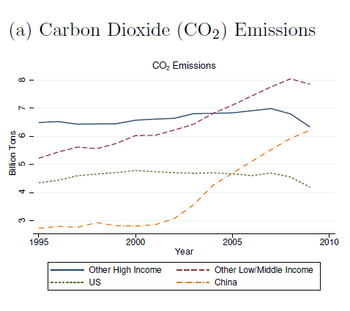
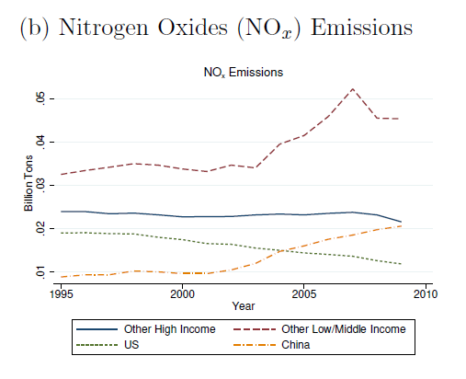
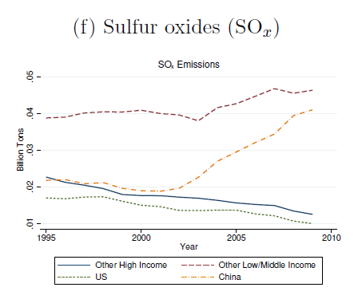
Pollution emissions over time
From Copeland et al. (2022)

Slide 7
Decomposing the environmental impacts of trade liberalization
In seminal work, Copeland and Taylor (1994) build a formal model to study how opening an economy to trade impacts the environment.
In summary, they decompose the overall impact into three effects:
Scale effects: opening an economy to trade promotes economic growth. Holding constant the mix of goods and production techniques, pollution is likely to increase as the economy grows in scale.
Production technique effects: an economy can change the pollution emitted per unit of output. In a growing economy, consumers become wealthier and demand cleaner production methods.
Composition effects: as an economy evolves, so does the share of national output that comes from cleaner or dirtier industries.

Slide 8
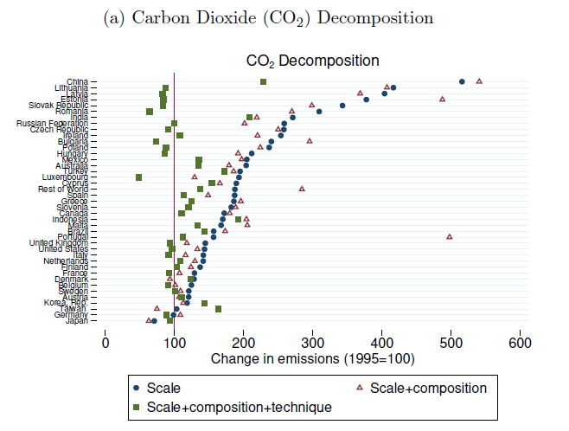
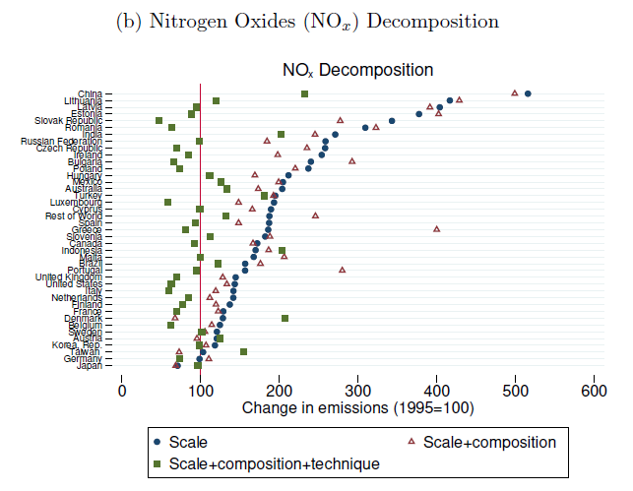
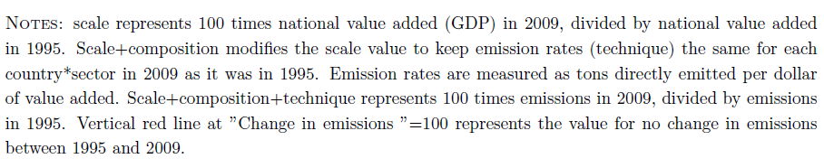
How did emissions decompositions
evolve from 1995-2009?
From Copeland et al. (2022)
Notes:
Scale: real growth in GDP from 1995 to 2009. So how emissions would have looked with techniques and the compositional mix used in 1995.
Composition: how emissions evolved due strictly to compositional changes in the economy
Technique: actual change in emissions.

Slide 9
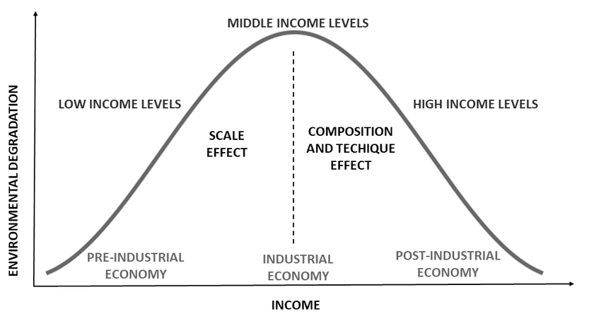
Where does that leave us?
We can tell a reasonable story of trade being beneficial to the environment:
A country opens to trade.
This results in growth and likely increased pollution, but with growth comes higher consumer income.
Since environmental quality is a normal good, demand for environmental quality rises with income.
Through policy (or otherwise), production techniques are implemented and reduce pollution on both production and consumption sides of economy.
Maybe economy’s composition becomes cleaner.
Empirics suggest whether environmental quality rises or falls is a function of the technique effect’s size.
Environmental Kuznets Curve
Lingering question(s): are trade’s effects on the environment different than the effects from growth? Can we expect the growth path of a country to be cleaner if it is more open to trade?

Slide 10
Roadmap
The effect of trade on the environment
The effect of environmental policy on trade (and the environment)
Trade policy as environmental policy?
Leakage and border pollution taxes
International Environmental Agreements

Slide 11
Q1: How do environmental policy and trade interact to affect production-generated pollution?

Slide 12
Pollution haven hypothesis
Trade theory suggests that if a country has a comparative advantage in pollution-intensive industries, then liberalizing that country’s trade policy will result in a composition effect where production shifts to more polluting industries.
Conversely, a trade-induced composition effect in countries with low-pollution production would shift further to clean industries.
The pollution haven hypothesis suggests environmental regulation is a crucial driver of this comparative advantage: that countries with relatively weak environmental regulation will attract “dirty” industrial production.
Intuition is straightforward: more stringent environmental policy increases a country’s cost of production. This results in reduced exports and discourages foreign direct investment.

Slide 13
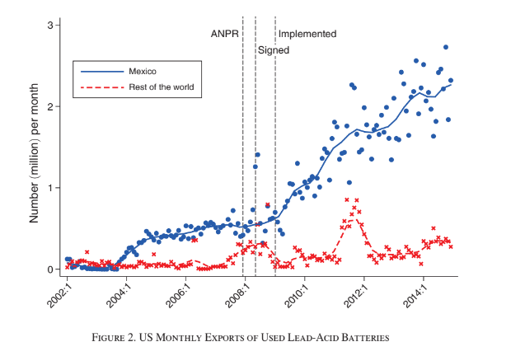
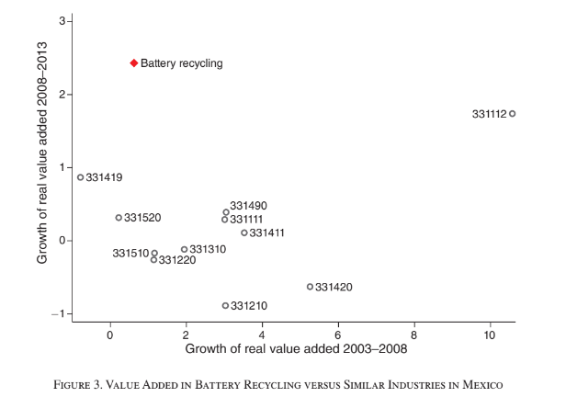
Pollution haven hypothesis
Overall, recent body of evidence is supportive of a limited pollution haven effect.
One very compelling representative result is from Tanaka et al. (2022).
They provide evidence that when the US tightened the NAAQS for lead in 2009, the recycling of used lead-acid batteries relocated to Mexico.
They also show that the corresponding increases in ambient lead pollution near Mexican battery-recycling plants resulted in 4.8% increase in the incidence of low birthweight hospital births.

Slide 14
Pollution haven hypothesis
Less evidence supporting a strong version of the pollution haven hypothesis: that differences in environmental policy are pivotal in determining comparative advantage.
There are many factors that are more likely to determine trade flows and comparative advantage: technology, factor abundance, distance, agglomeration, etc.
While on the margin, environmental policy may contribute to a comparative disadvantage in pollution-intensive industries, a wide body of evidence shows these other factors to be first-order concerns, while environmental policy might be second- or third-order.
Under some conditions, a causal shift of some pollution-intensive industries to other countries with weaker regulation may occur, but it does not seem to be systematic.

Slide 15
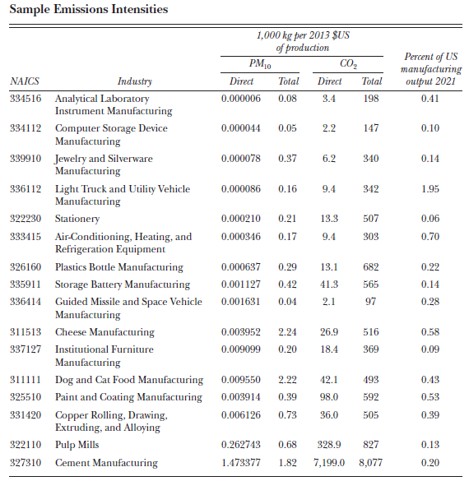
Pollution offshoring hypothesis
Modern supply chains are incredibly fragmented. It takes many intermediate production steps to reach a final good.
And direct emissions from production in a given industry are often only a small fraction of total emissions produced along the supply chain up to that point.
Levinson (2023)

Slide 16
Pollution offshoring hypothesis
Is there evidence that firms outsource the “dirty” parts of their production process or supply chain to countries with weaker environmental regulation?
If so, what we observe as a large industrial “technique” effect in countries with stricter regulation might simply be the offshoring of intermediate emissions.
There does seem to be limited empirical work supporting this hypothesis.
Michel (2013): Belgian firms substitute towards imported intermediates, which lowers domestic emission intensity.
Cherniwchan (2017): NAFTA induced US firms to purchase dirty intermediates, which lowered US manufacturing intensity.
Li and Zhou (2017): US plant-level emissions are lower when the plant’s parent company imports more intermediates from low wage countries.
Cole et al. (2017): Japanese firms outsourcing production internationally have lower carbon emission intensity than those that outsource domestically.

Slide 17
Q2: How do environmental policy and trade interact to affect consumption-generated pollution?

Slide 18
Consumption-generated pollution
Like in the production case, one can think of separate scale, composition, and technique effects resulting from trade.
Scale: as trade increases real income, consumption of goods (and ceteris paribus, pollution) will increase.
Composition: relative price changes, access to different mixes of products, and shifts in consumer preferences as they become wealthier have an ambiguous effect on pollution.
Technique: the effect on consumption-generated pollution is ambiguous. If environmental policy or corporate ESG initiatives become more common due to consumers’ new wealth and tastes, likely to reduce pollution.

Slide 19
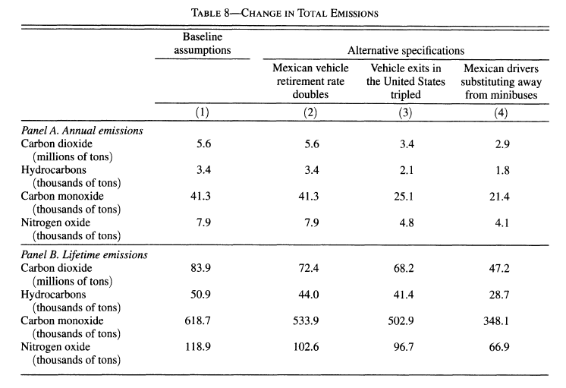
Consumption-generated pollution
One empirical example of this is Davis and Kahn (2010).
They study how pollution evolved after NAFTA opened trade of used vehicles from the US to Mexico in 2005.
These used vehicles were less emission intensive than the US average, but more emission intensive than the Mexican average.
Opening of trade resulted in decreased US emissions. (Due to US policy – new cars have modern CAFE standards to meet).
Trade opening resulted in increased Mexican emissions: the scale effect of additional cars outweighed the composition effect.

Slide 20
Q3: How do environmental policy and trade interact to affect transport-generated pollution?

Slide 21
Transport-generated pollution
The opening of trade creates a demand for additional transportation of goods.
Physics 101: you can’t move something without energy. (Newton, 1687)
In modern times (though perhaps less in historic and very recent times), energy for transportation requires the generation of pollution.
So a marginal increase in trade-generated transportation almost systematically increases pollution.
But: are increases in transportation emissions offset by a more efficient supply chain? And are the environmental costs of this pollution large in relation to welfare gains from trade that result from transport?

Slide 22
Transport-generated pollution
Some stylized facts from Cristea et al. (2013) and Shapiro (2016):
CO2 generated by trade-related transport makes up less than 4% of global emissions.
But: transport emissions make up 35% of total emissions from traded goods!
Surprising which goods are “clean”/”dirty”, accounting for transportation.
Commodities are energy-intensive to produce but often shipped efficiently by sea.
Machinery/electronic equipment efficiently produced but shipped by air – dirty!
Compared to autarkic world, current international trade practices increase CO2 emissions by only 5% annually.
At a SCC of ~$30, the global welfare gains from trade exceed the costs of CO2 emissions by a factor of 160x.

Slide 23
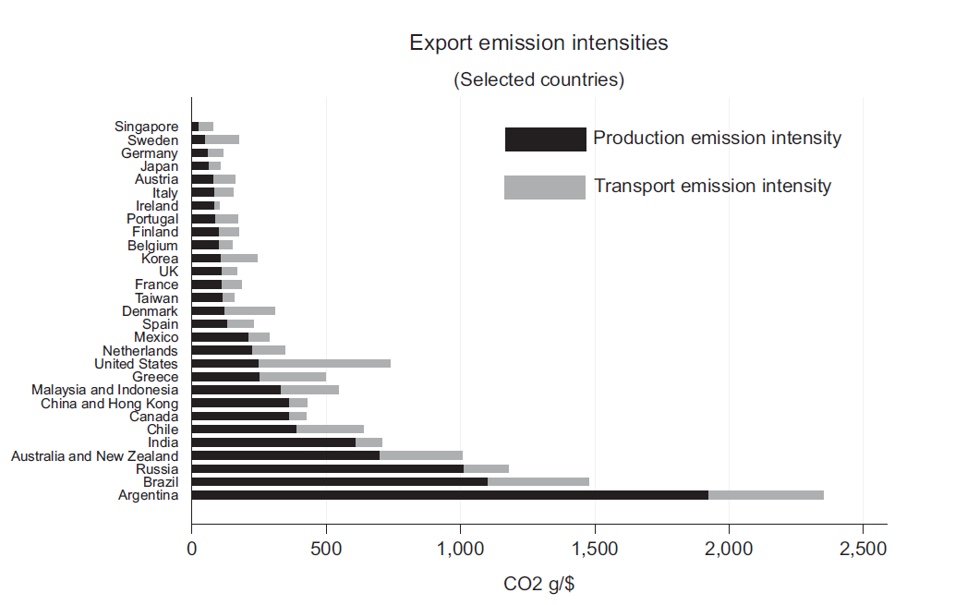
Transport-generated pollution
Notes:
Note: older data (2004) but the point still stands.

Slide 24
Transport-generated pollution
Some stylized facts from Cristea et al. (2013) and Shapiro (2016):
CO2 generated by trade-related transport makes up less than 4% of global emissions.
But: transport emissions make up 35% of total emissions from traded goods!
Surprising which goods are “clean”/”dirty”, accounting for transportation.
Commodities are energy-intensive to produce but often shipped efficiently by sea.
Machinery/electronic equipment efficiently produced but shipped by air – dirty!
Compared to autarkic world, current international trade practices increase CO2 emissions by only 5% annually.
At a SCC of ~$30, the global welfare gains from trade exceed the costs of CO2 emissions by a factor of 160x.

Slide 25
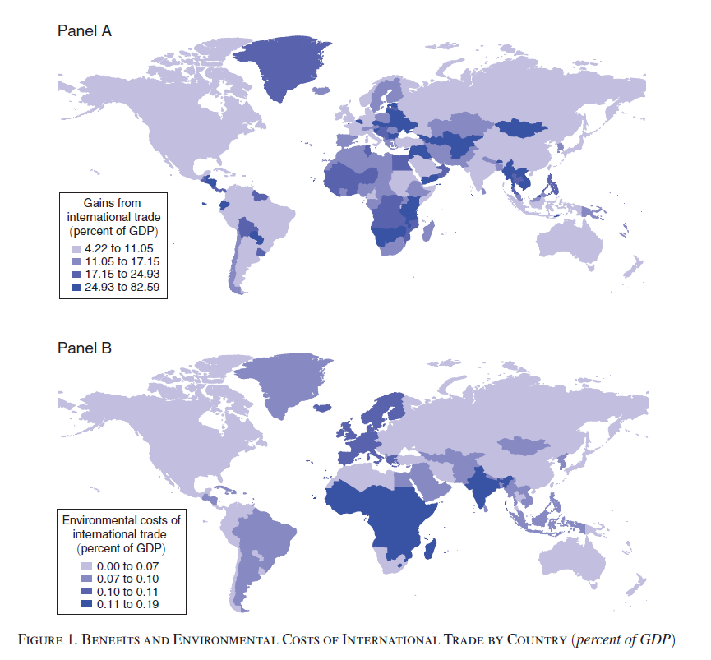
Transport-generated pollution

Slide 26
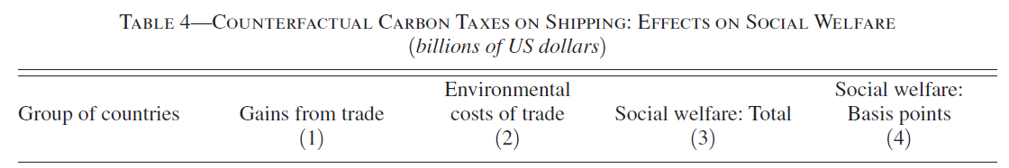
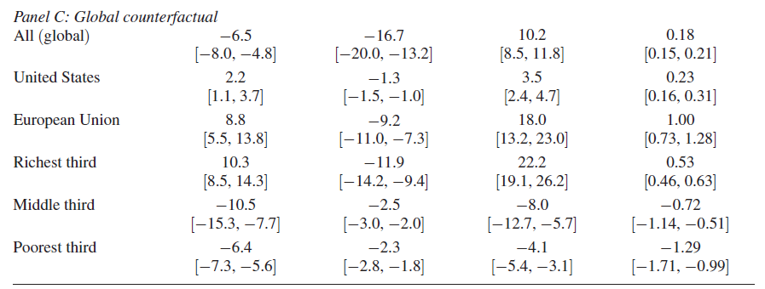
Transport-generated pollution
Building on that last result, Shapiro (2016) asks:
What happens to welfare if a global carbon tax on shipping of $30/ton is imposed?

Slide 27
Roadmap
The effect of trade on the environment
The effect of environmental policy on trade (and the environment)
Trade policy as environmental policy?
Leakage and border pollution taxes
International Environmental Agreements

Slide 28
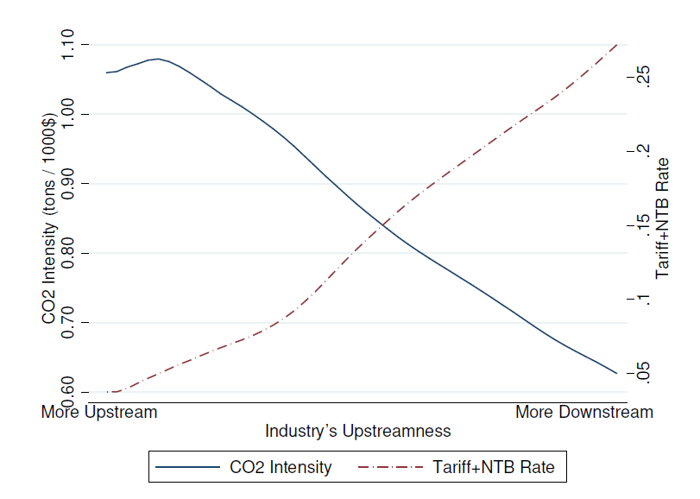
Trade policy as environmental policy?
In a 2021 paper, Shapiro notes that existing global trade policy is distorted towards promoting trade in carbon-intensive goods.
The existing global tariff structure (likely due to lobbying) is one where tariffs are low on imported inputs and high on final goods (to protect high-margin domestic production).
Shapiro asks: what happens to trade and carbon emissions if all countries simplify trade policy via a single tariff rate per trading partner (taken at the bilateral-average) for all goods?
Result: 0.65% increase in global income and 3.6% decrease in global carbon emissions.

Slide 29
Second-best policy for trade and the environment
In cases where a market distortion can’t be removed due to technical reasons, politics, distributional effects, etc., economists advocate for a second-best policy.
When making second-best policy, adding an additional distortion in an interdependent market might lead to a more efficient outcome.
When addressing environmental issues, we are often in a second-best world.
Example: Costello and McAusland (2004) suggest that using a commodity import tariff as a Pigouvian tax can deter invasive species introduction by reducing both import volume and infestation levels.
Example: In 2010, China increased export restrictions on rare earth metals, claiming the restrictions were necessary to reduce pollution. This “environmental policy” resulting in massive price increases and gains in trade. In 2015, the WTO ruled against China, saying the restrictions were clearly not necessary to reduce pollution.

Slide 30
Roadmap
The effect of trade on the environment
The effect of environmental policy on trade (and the environment)
Trade policy as environmental policy?
Leakage and border pollution taxes
International Environmental Agreements

Slide 31
Climate policy and carbon leakage
We’ve discussed pollution generally thus far, but let’s now focus on carbon emissions.
Carbon emissions are a global pollutant, and there is not an “international” level of government that can overrule national sovereignty in order to correct the externality.
Imagine a coalition of countries agrees to reduce carbon emissions. What do we expect to happen to emissions in non-coalition countries?
Coalition production of carbon-intensive goods will become less competitive globally, production may be offshored resulting in increased non-coalition emissions.
Coalition demand for fossil fuels will decline. The global price of fossil fuels will respond in kind (decreasing) thus encouraging increased use in non-coalition countries
Increased emissions in non-coalition countries is leakage that undermines the coalition’s climate policy.

Slide 32
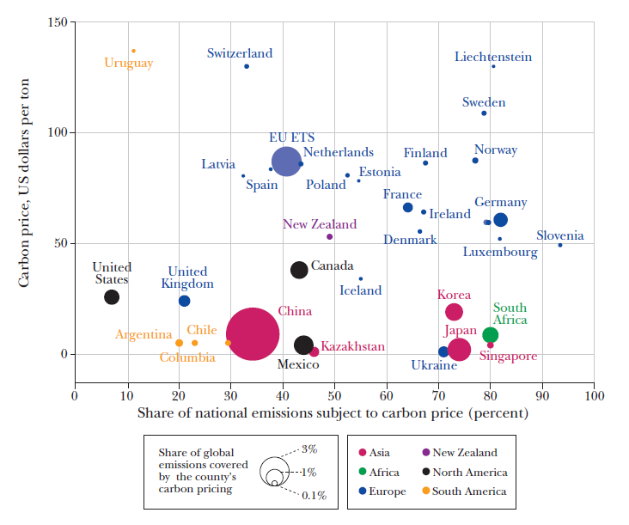
Carbon pricing, leakage and trade
This leakage can even occur in countries with climate policy and generate trade or competitiveness concerns.
Consider the global heterogeneity in carbon prices and coverage, and ask yourself how this variation might affect trade…
Clausing and Wolfram, 2023

Slide 33
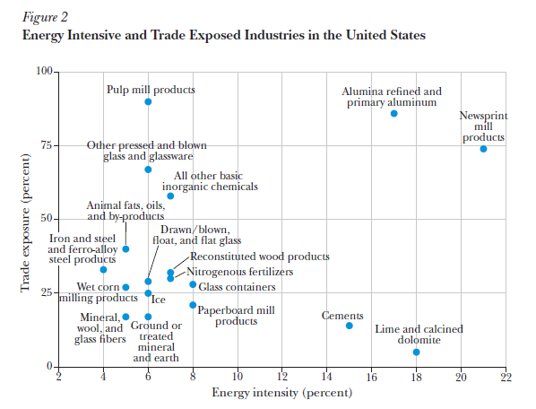
Carbon pricing, leakage and trade
Imagine the US implements a carbon price in the form of a $100/ton tax.
US production now must compete with production from other parts of the world that don’t cost this carbon price.
The further to the NE of graph at right, the more the industry is exposed to this competition .
Clausing and Wolfram, 2023

Slide 34
Carbon pricing, leakage and trade
A standard approach to partially mitigate these trade competitiveness effects is to use a cap-and-trade system with grandfathering (see lecture 16).
Note: free permit allocations will only cover direct costs. If input costs (e.g. energy) are more expensive, this will still pass through to firms.
When jurisdictions are reluctant to directly impost carbon costs on firms/consumers (perhaps for political economy reasons), they can instead turn to subsidies.
This is the carbon-policy path the US government has recently taken. Dr. Austin will discuss the Inflation Reduction Act (IRA) and Infrastructure Bill next week.
Carbon subsidies have the opposite competition effect on trade: foreign countries are likely to suffer from the treatment benefits handed to domestic industry
In response to the IRA’s advantageous subsidy treatment for “American-made” products, the EU has discussed retaliatory industrial policy.
Tit-for-tat trade policy can (theoretically) result in an expensive subsidy race

Slide 35
Carbon border adjustments
More recently, carbon border adjustment mechanisms have become a popular way to protect domestic industry when implementing carbon pricing.
For example, a jurisdiction with carbon pricing can apply import fees based on the carbon content of imported goods.
Imagine a jurisdiction has a $100 per ton carbon tax and imports a good from a foreign market with a $10 per ton carbon tax.
The jurisdiction can impose a border adjustment tariff of $100 per ton of carbon embedded in the good.
The result: all domestic consumption of the good face identical carbon costs.
Earlier this year, the EU finalized an agreement to implement this kind of policy to offset competitive disadvantages that have accrued due to EU carbon pricing.
Note, however, that this does not help the jurisdiction with export competition.

Slide 36
Roadmap
The effect of trade on the environment
The effect of environmental policy on trade (and the environment)
Trade policy as environmental policy?
Leakage and border pollution taxes
International Environmental Agreements

Slide 37
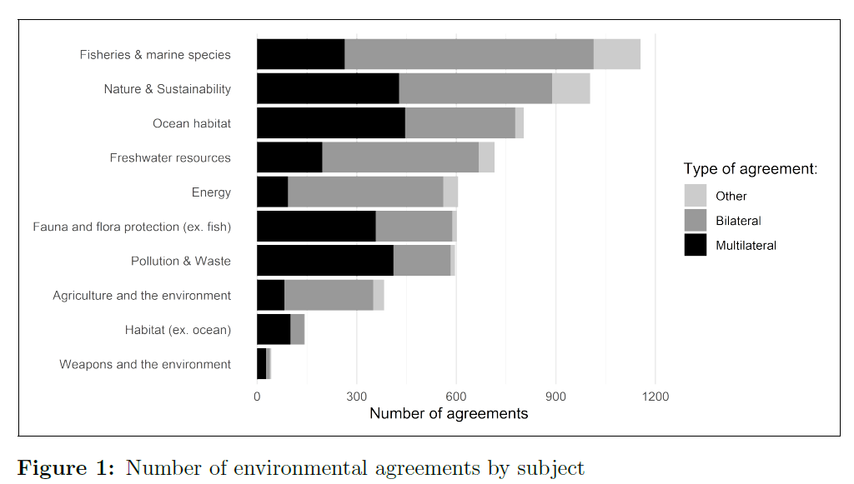
International Environmental Agreements
IEAs are often the only viable solution to solving global, transboundary pollution problems.
Climate IEAs are obviously the big fish, but to date more than 3,000 IEAs have been identified.
Bellelli et al. (2023)

Slide 38
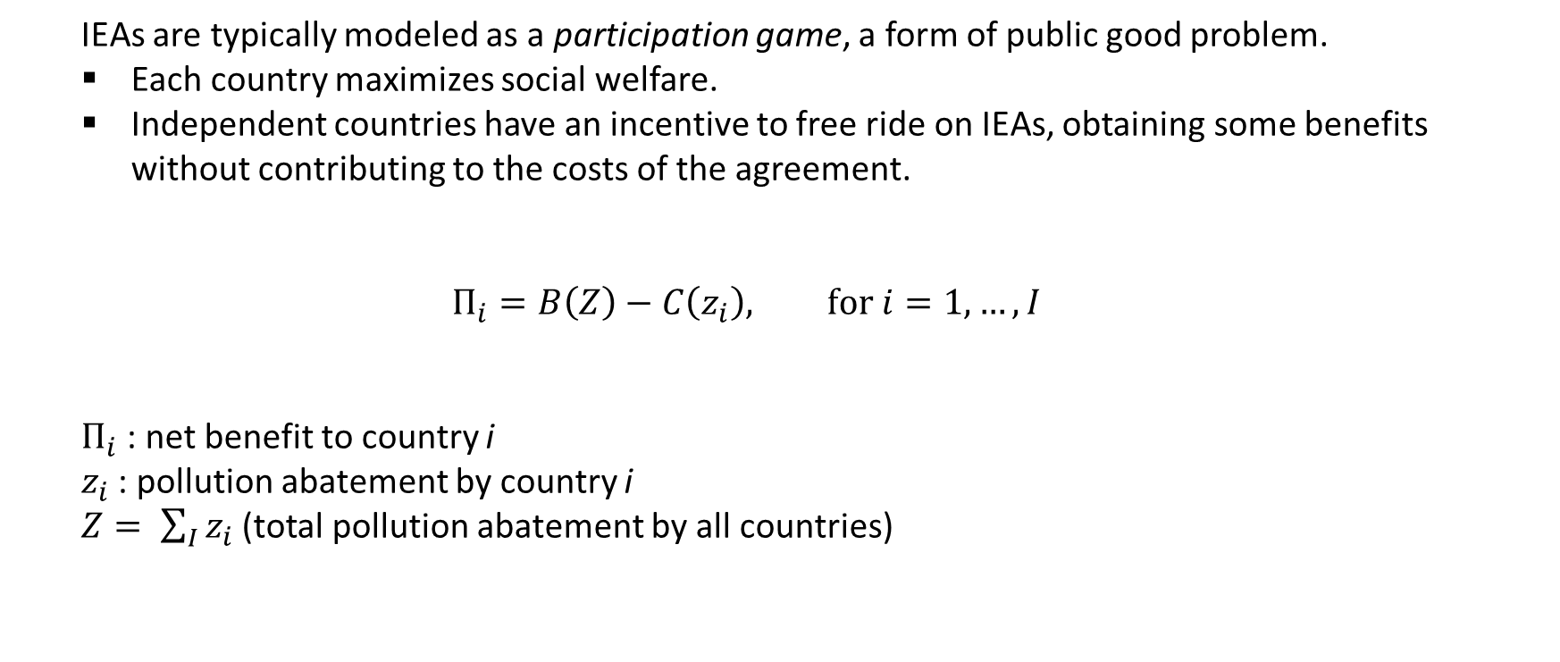
International Environmental Agreements
IEAs are typically modeled as a participation game, a form of public good problem.
Each country maximizes social welfare.
Independent countries have an incentive to free ride on IEAs, obtaining some benefits without contributing to the costs of the agreement.
$$Π_{i}=B\left(Z\right)−C\left(z_{i}\right), for i=1,…,I$$
$Π_{i}$ : net benefit to country i
$z_{i}$ : pollution abatement by country i
$Z= \sum_{I}{z_{i}}$ (total pollution abatement by all countries)

Slide 39
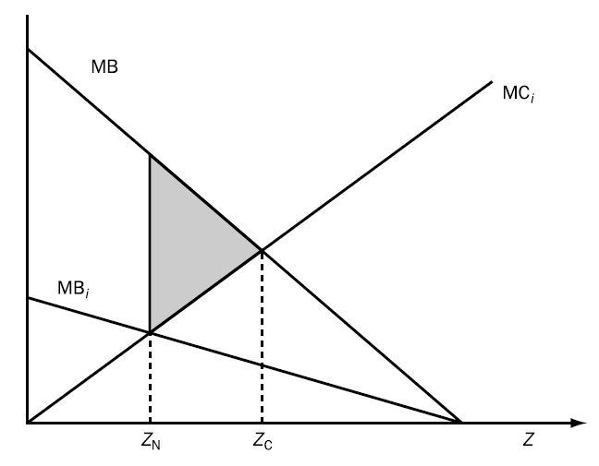
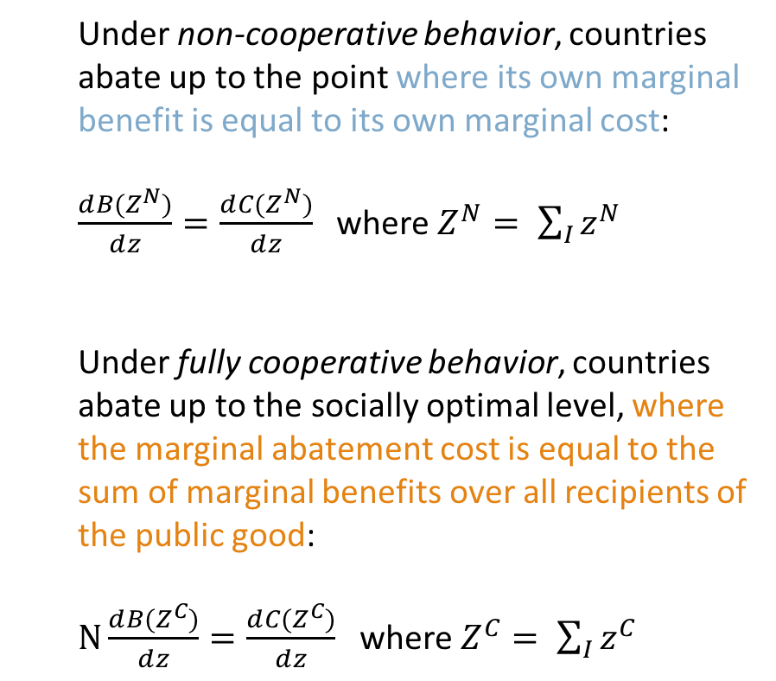
International Environmental Agreements
Under non-cooperative behavior, countries abate up to the point where its own marginal benefit is equal to its own marginal cost:
$\frac{ⅆB(Z^{N})}{ⅆz}=\frac{ⅆC(Z^{N})}{ⅆz}$ where $Z^{N}= \sum_{I}{z^{N}}$
Under fully cooperative behavior, countries abate up to the socially optimal level, where the marginal abatement cost is equal to the sum of marginal benefits over all recipients of the public good:
$N\frac{ⅆB(Z^{C})}{ⅆz}=\frac{ⅆC(Z^{C})}{ⅆz}$ where $Z^{C}= \sum_{I}{z^{C}}$
Notes:
This picture is useful because it shows us what determines the size of two magnitudes of interest:
- the amount by which full cooperation abatement exceeds non-cooperative abatement (i.e. ZC − ZN);
the magnitude of the efficiency gain from full cooperation (the shaded triangular area in the diagram).
It is evident that these depend on two things:
1. the relative slopes of the MBi and MCi curves;
2. the number of competing countries, N (as this determines the relative slopes of the MBi and MB curves.

Slide 40
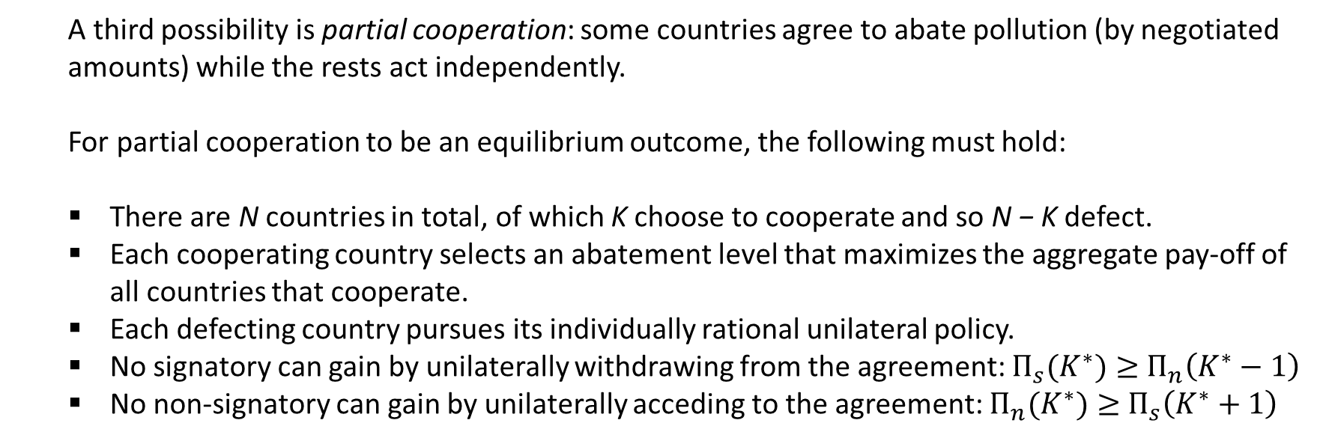
International Environmental Agreements
A third possibility is partial cooperation: some countries agree to abate pollution (by negotiated amounts) while the rests act independently.
For partial cooperation to be an equilibrium outcome, the following must hold:
There are N countries in total, of which K choose to cooperate and so N − K defect.
Each cooperating country selects an abatement level that maximizes the aggregate pay-off of all countries that cooperate.
Each defecting country pursues its individually rational unilateral policy.
No signatory can gain by unilaterally withdrawing from the agreement: $Π_{s}(K^{∗})≥$ $Π_{n}\left(K^{∗}−1\right)$
No non-signatory can gain by unilaterally acceding to the agreement: $Π_{n}(K^{∗})≥$ $Π_{s}\left(K^{∗}+1\right)$

Slide 41
International Environmental Agreements
Barrett (1995) summarizes the key implications of any such equilibrium:
When there are large potential gains from cooperation, the benefits from free-riding are also larger, and so defection is more attractive.
When the incentives to defect are larger, there will be a smaller number of signatories.
Thus, there is a trade off between the level of participation in environmental agreements that can be attained (breadth) and the abatement commitments implied by the treaty (depth).
Full cooperation is an especially rare outcome.
Barrett’s dismal punchline: any IEA with a large number of signatories is limited in its capacity to deliver social benefits. Thus, treaties tend to simply codify actions that nations are already taking.

Slide 42
What is the most successful IEA you have heard of?

Slide 43
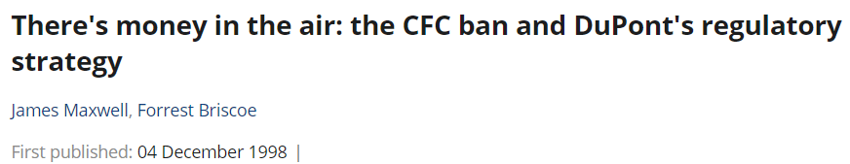
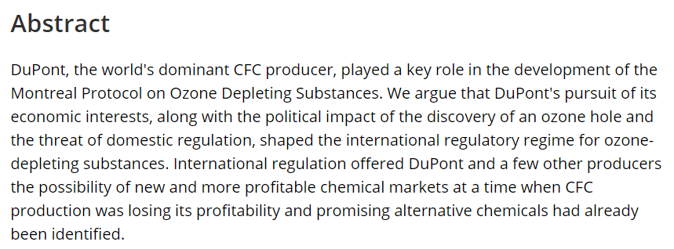
International Environmental Agreements
Some people argue the Montreal Protocol was only a success because private industry saw an opportunity to consolidate market power, and made government buy-in less politically costly:

Slide 44
International Environmental Agreements
Okay, enough pessimism.
What are some factors or approaches that improve the probability of an IEA succeeding?
Bellelli et al. (2023) review the empirical evidence and find:
Regional IEAs are substantially more likely to be ratified; likely because of mutual economic interests, cultures, and similar benefit/cost functions.
Can a combination of regional IEAs outperform a global agreement on participation?
Side payments – through financial or technical support to developing countries – increase the likelihood of ratification, at least initially.
Early ratification by “big nations” increases ratification likelihood of other nations. This “domino effect” implies that a handful of countries are driving the success or failure of an IEA.

Slide 45

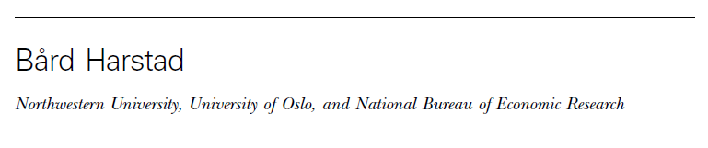
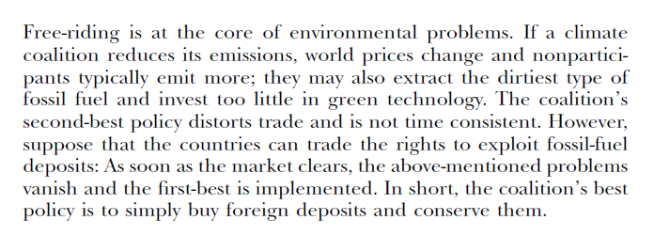

Slide 46
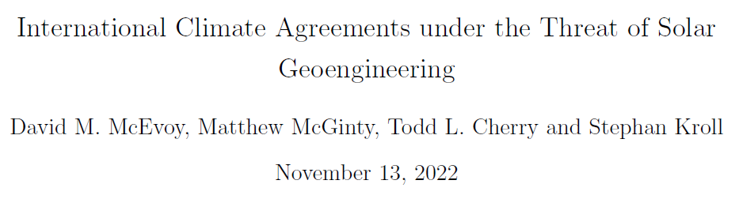
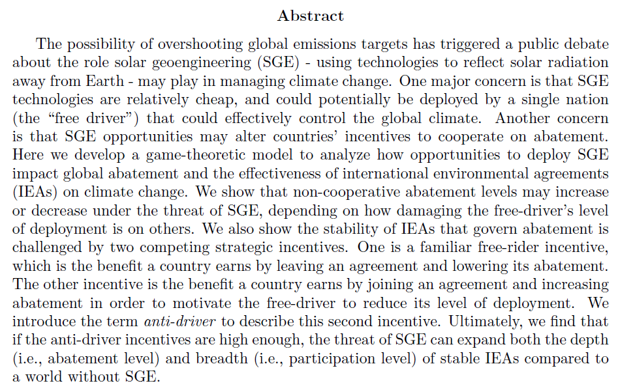

Slide 47
Next class
Next lecture is our last of the semester. Prof. Austin to cover some current environmental policy topics.
No readings beforehand – enjoy your Thanksgiving holiday!
Reminder to keep making progress on Case Study #4 (due Nov 27).

